Slide 1
Housekeeping Service
Name :- Dhrumil SHAH
En.no :- 181150107016
Subject :- Internship/project-3181601
Sem :- 8TH
Internal Guide name :- Twinkal patel Scet,kalol

Slide 2
Content
Company Overview
Introduction
Technical Description
Users
Login page
Functionalities of Admin
Functionalities of Housekeeper
Functionalities of Customer

Slide 3
Company Overview
UNNATI INFORMATICS LLP is an IT-based company in Ahmedabad.
UNNATI INFORMATICS is receptive to new ideas and promises help and support anytime and anywhere.
Vision :To become The Best IT Solutions and Services platform by giving optimal solutions to Businesses and Educational Institutions for their consistent growth.
Mission :To provide such software solutions that are functional, reliable, maintainable and cost-friendly to our existing and growing client and customer base.

Slide 4
Introduction
In this project we will book Housekeeping service in our area.
Our goal is to make it easier to book verefied Housekeeper Service For our daily needs.
It saves time and energy of Customers as well as Housekeeping service provider.
It will help customers to get the best Housekeeping Service easily and fast online at our fingertips.

Slide 5



Technical Description
Front-End : Bootstrap,HTML,CSS
Framework : Django
Database : Postgres

Slide 6
Users
Admin
Customer
Housekeeper

Slide 7
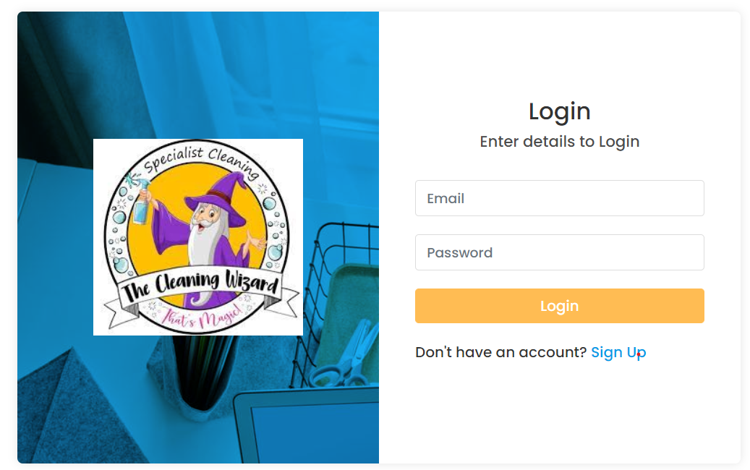
Login Page

Slide 8
Functionalities of Admin
Admin can add Service ,View Service,Update or Delete Service.
Admin can add verified Housekeeper,View all added Housekeeper,Update or Delete Housekeeper.
Admin can approve or reject customer booking.
Admin can Send Notification to the Housekeeper.
Admin can Approve or Reject Leave applied by the Housekeeper.

Slide 9
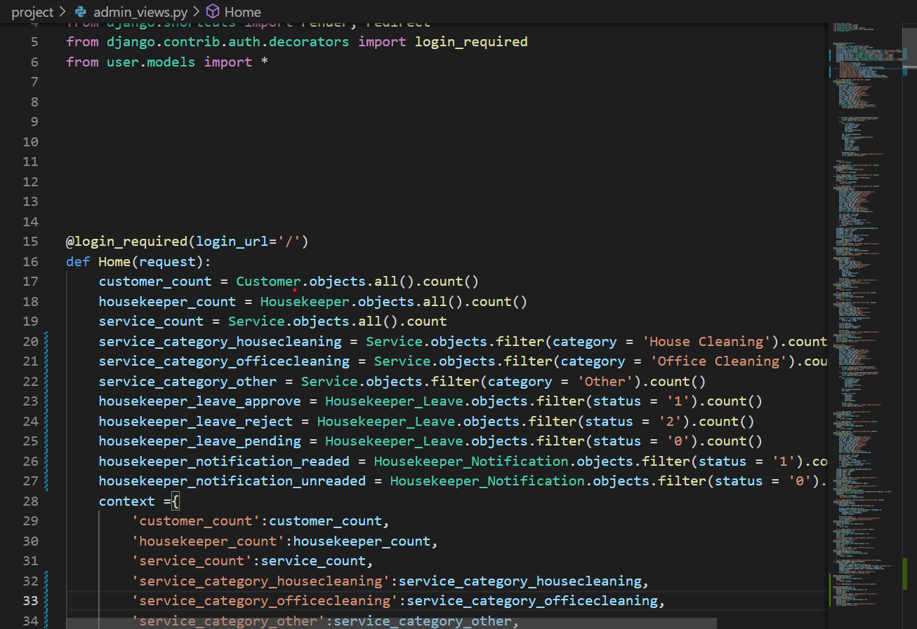
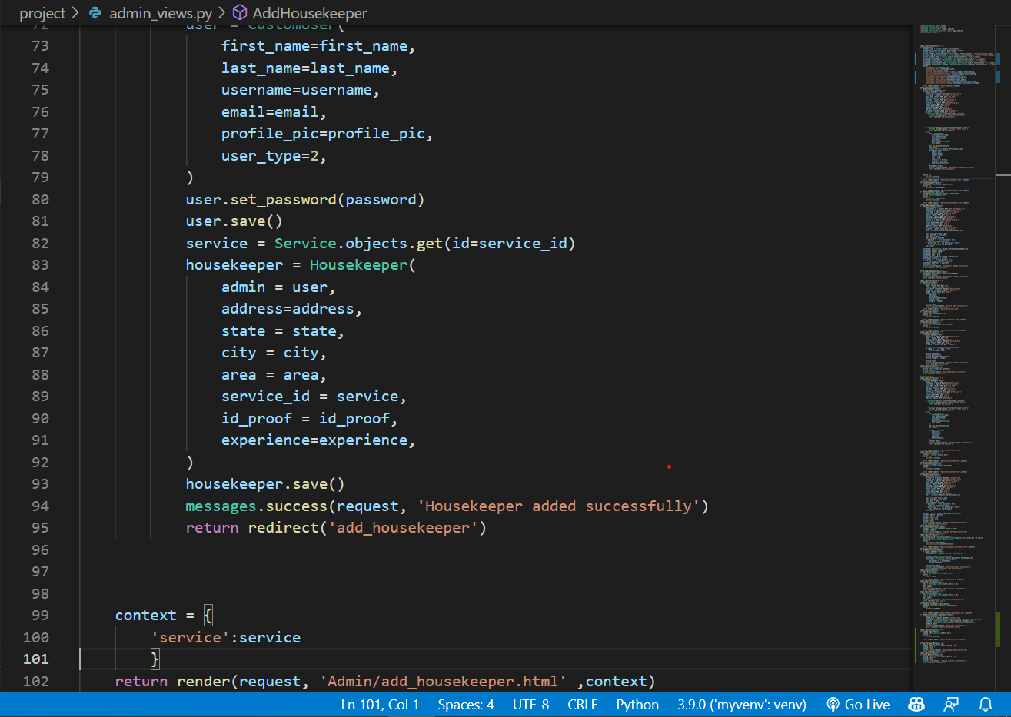
Adminviews.py

Slide 10
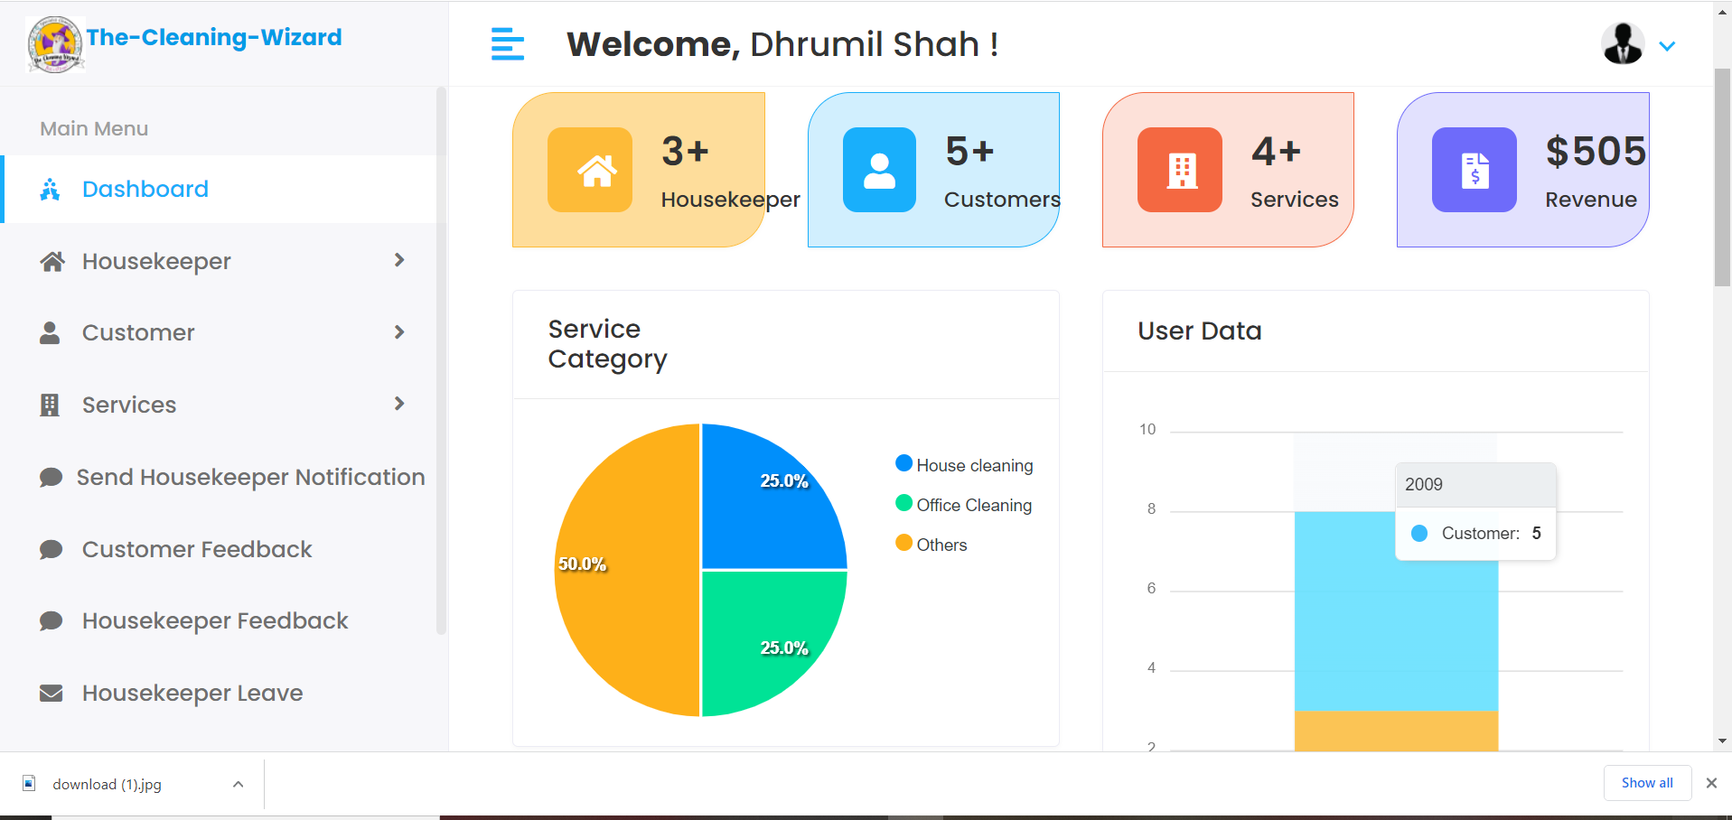
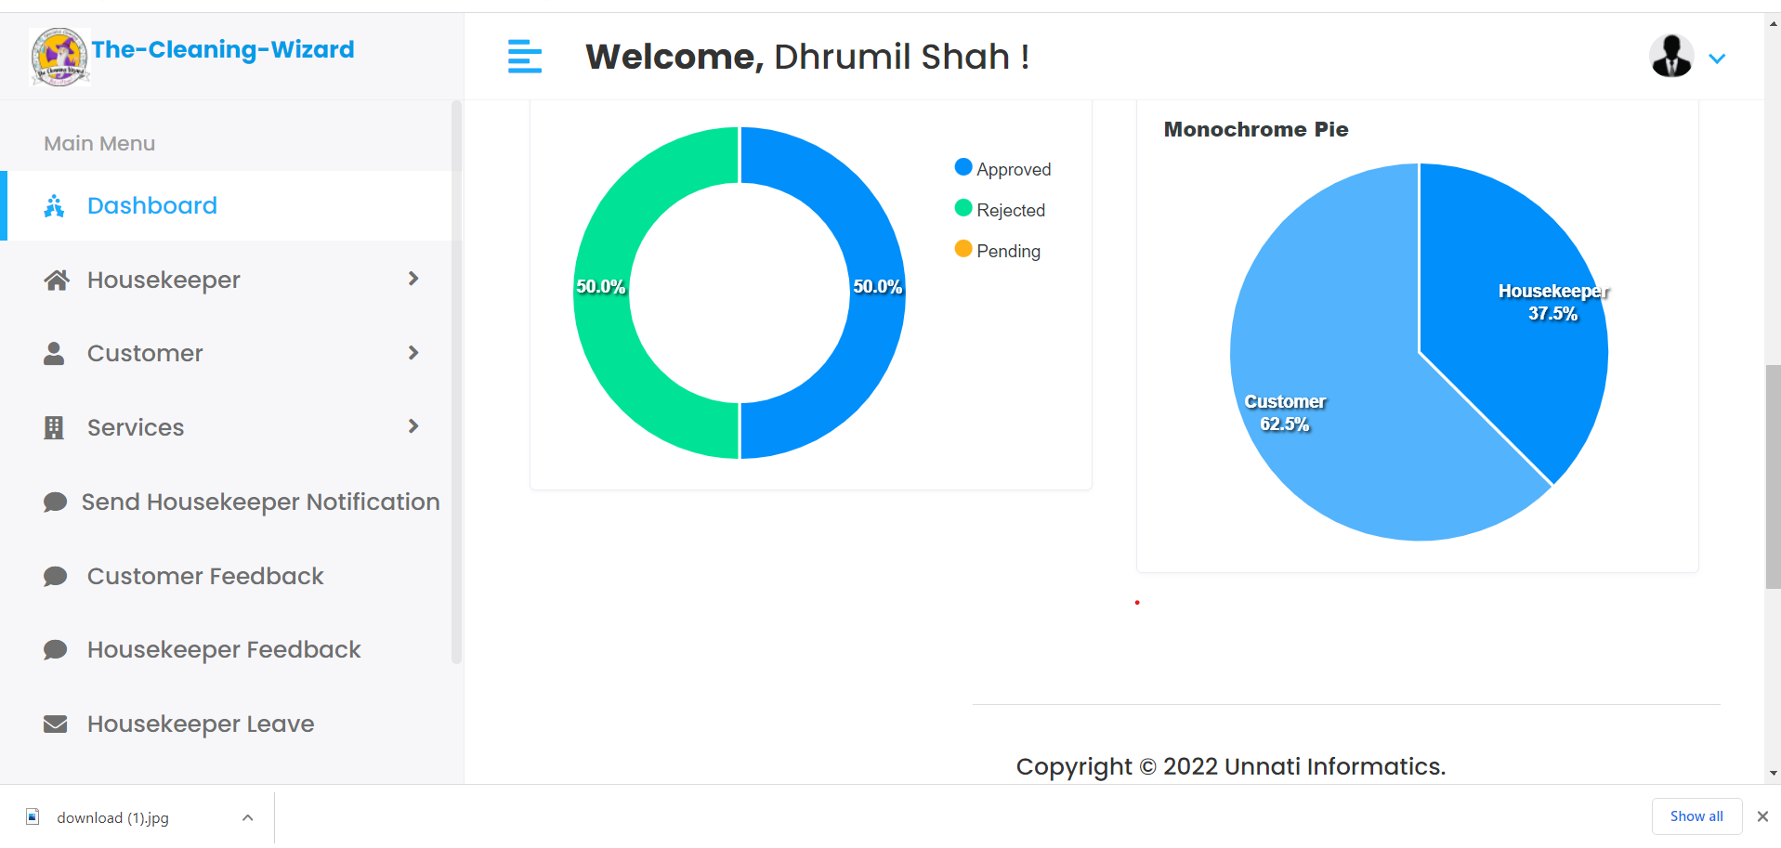
Admin Dashboard

Slide 11
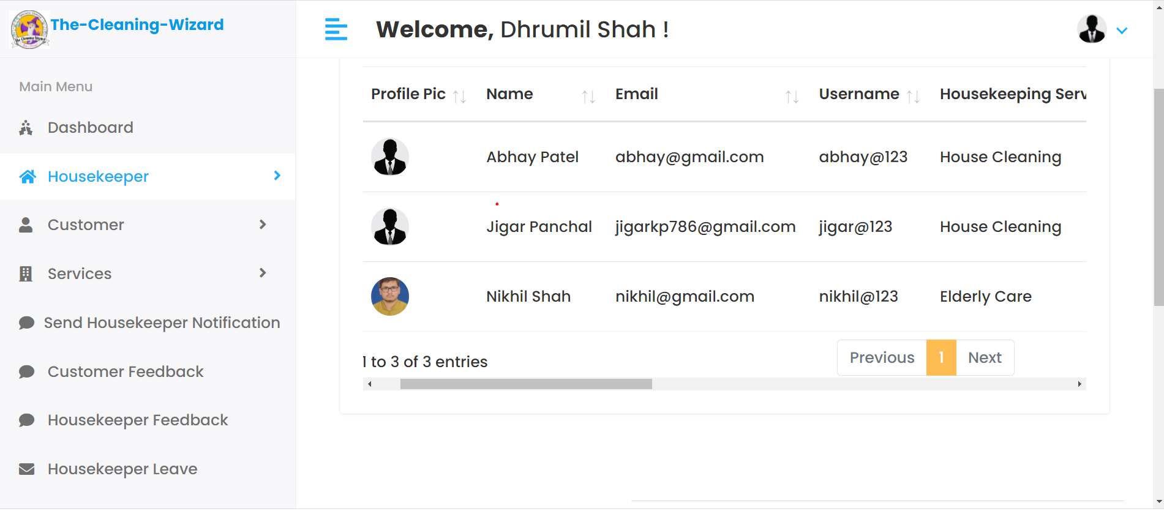
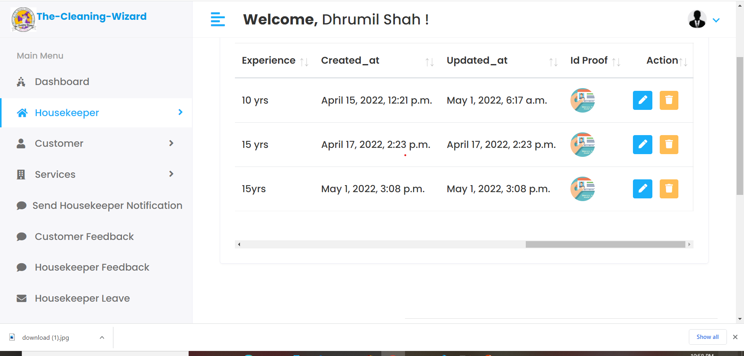
View Housekeeper

Slide 12
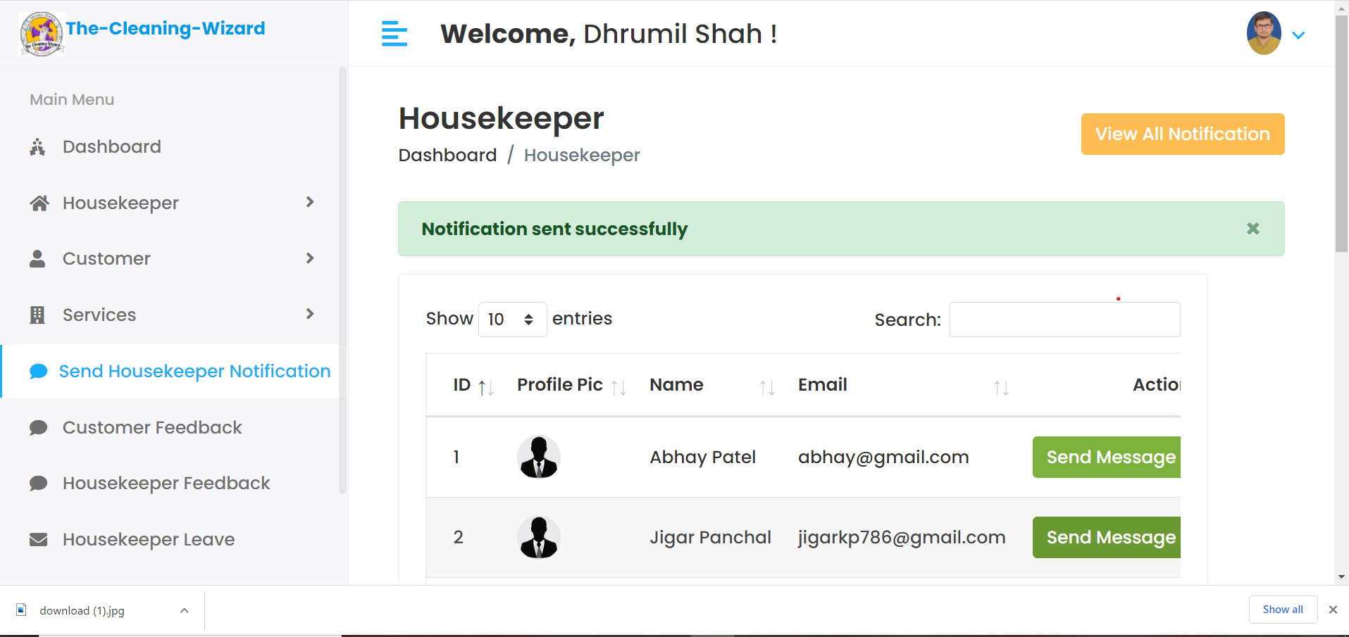
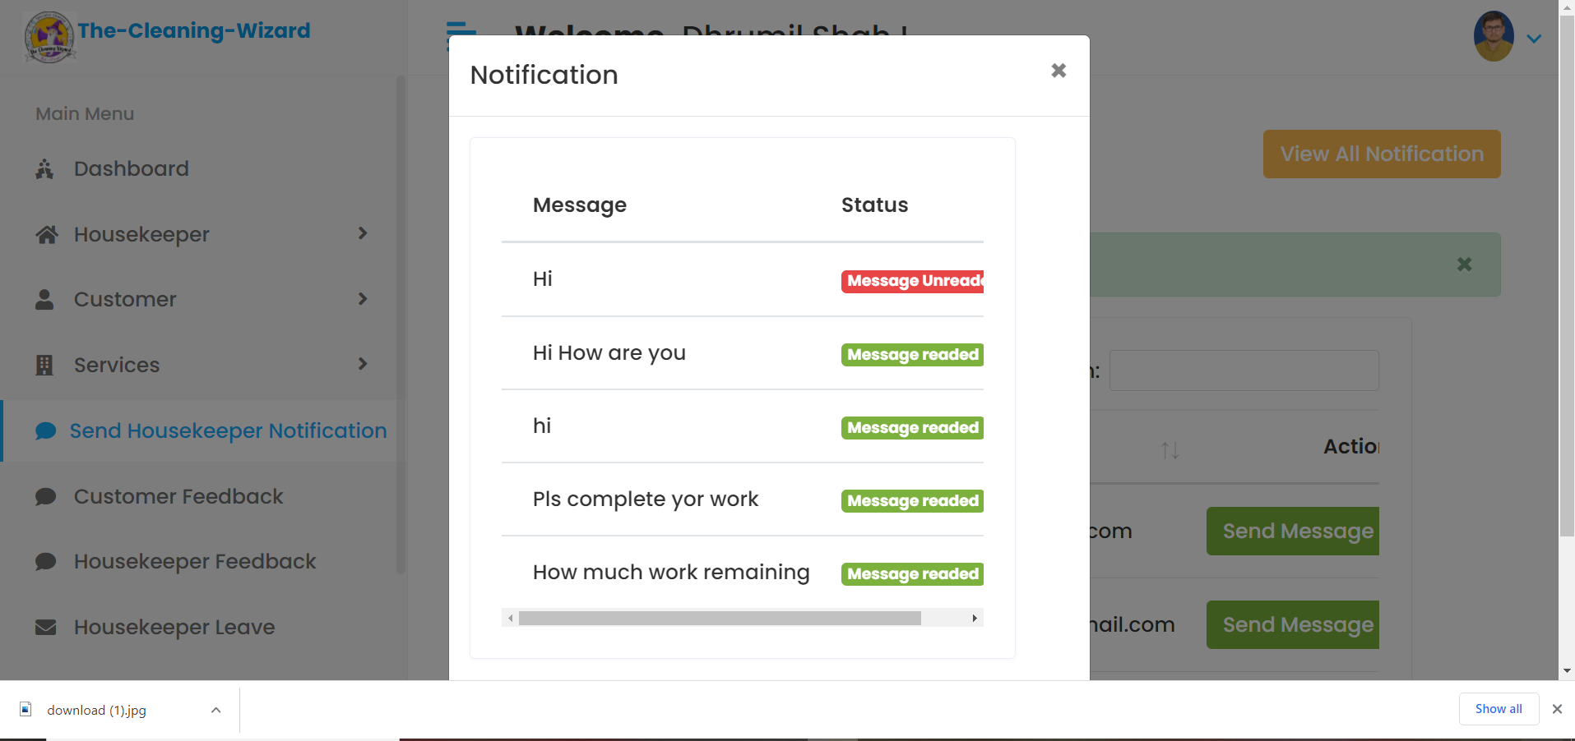
Send Housekeeper Notifications

Slide 13
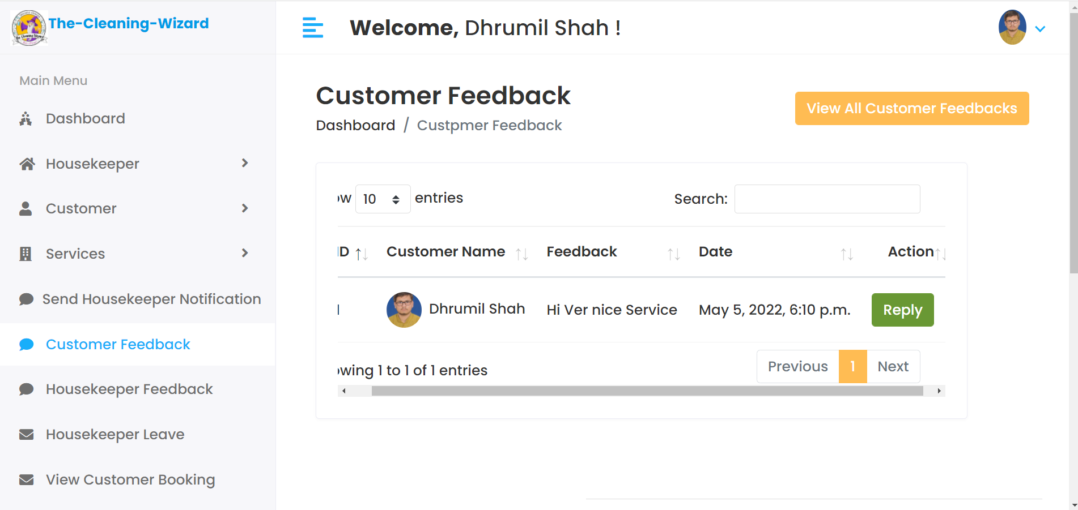
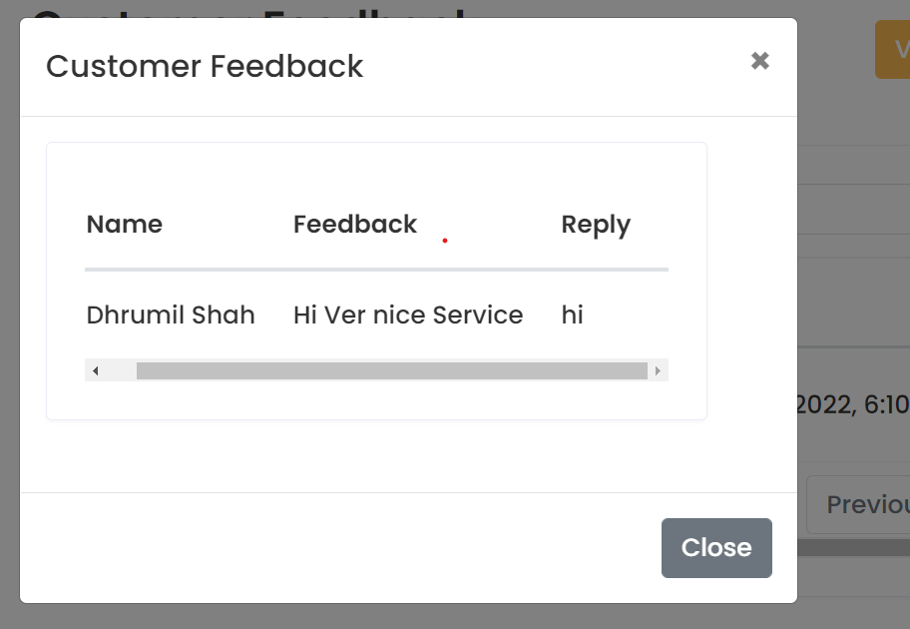
View Customer feedback and Reply

Slide 14
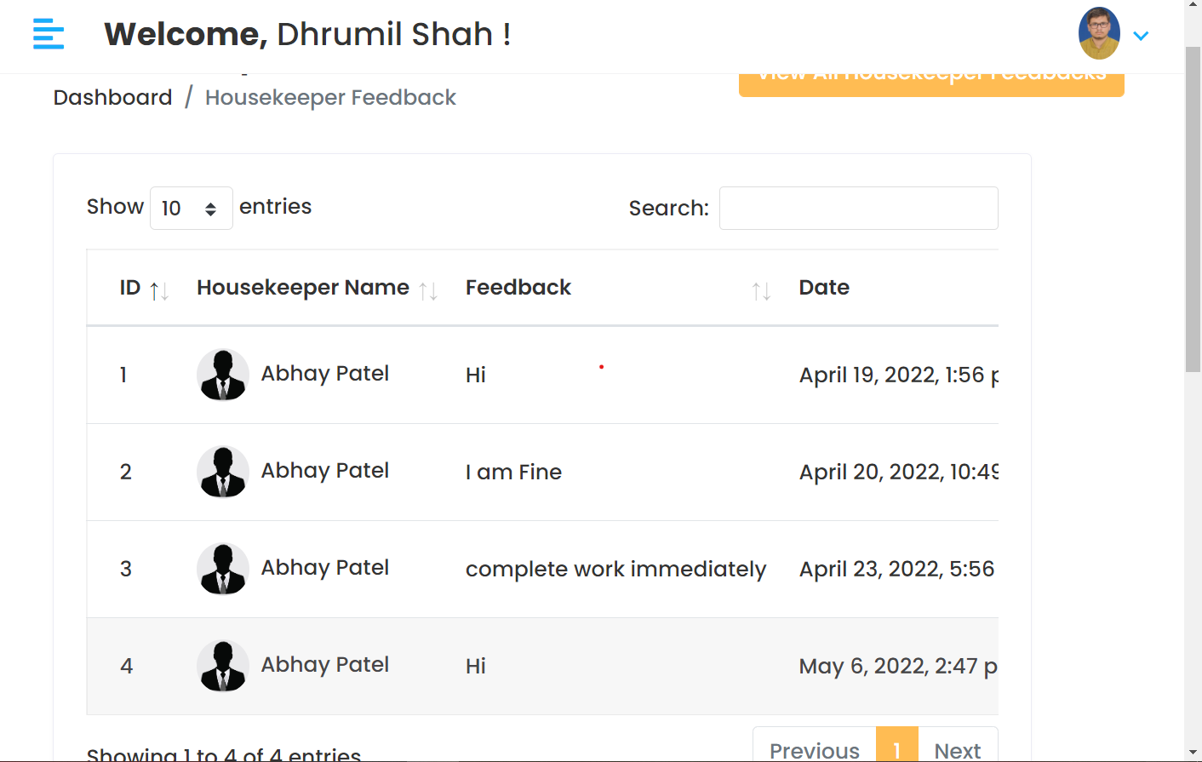
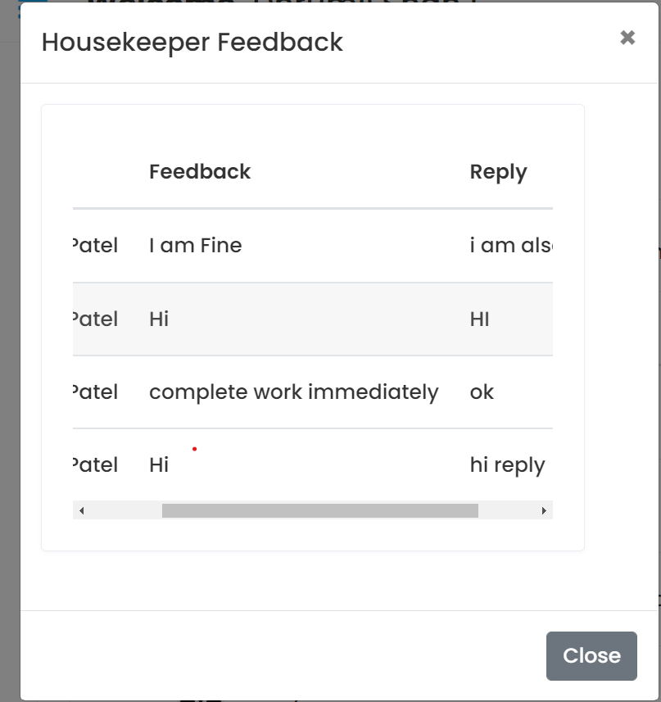
View Housekeeper Feedback and Reply

Slide 15
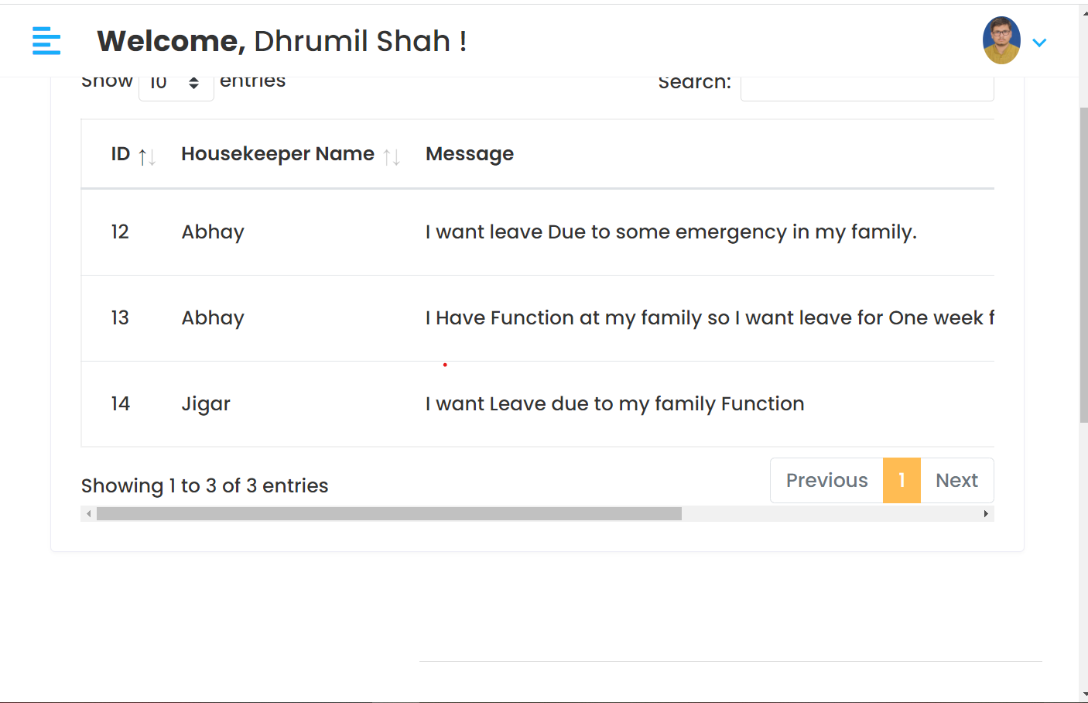
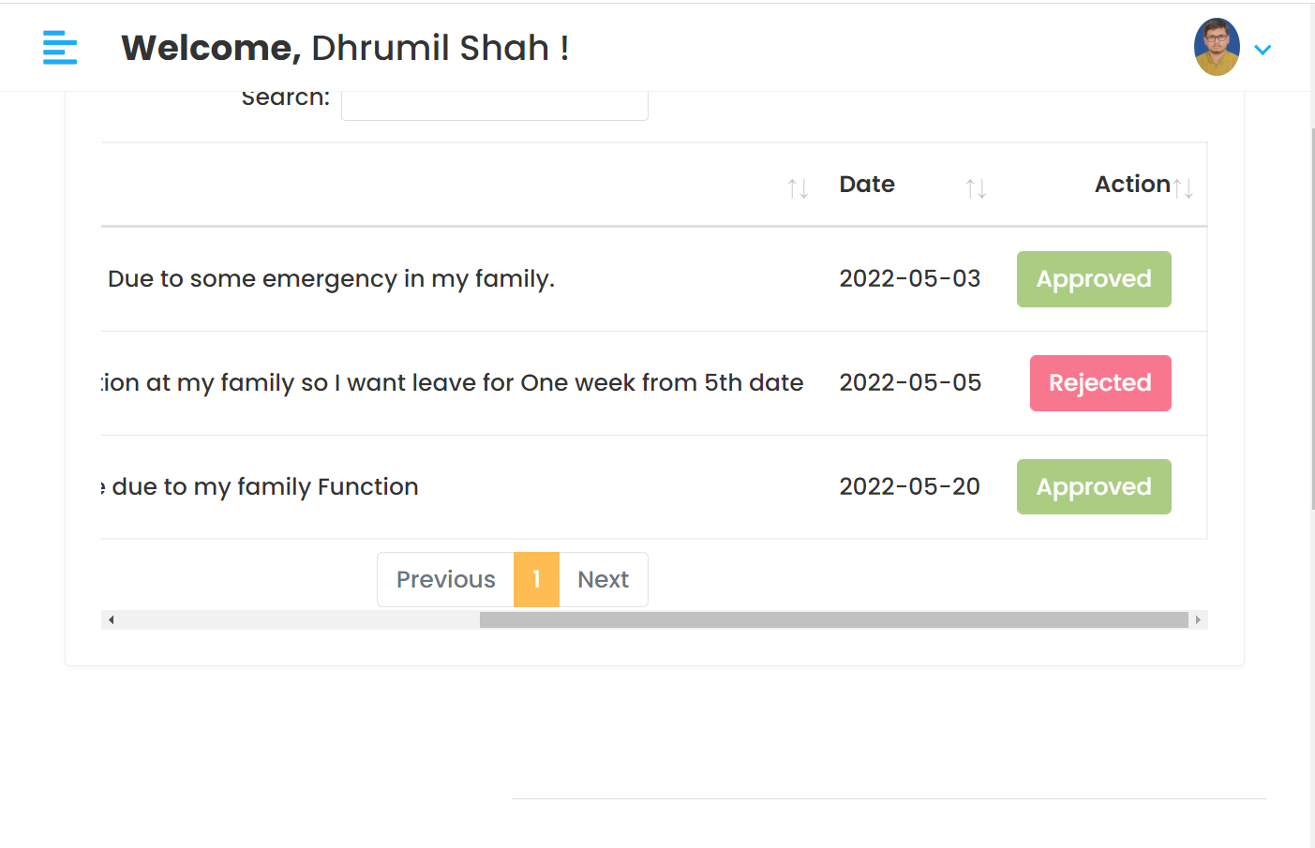
View Housekeeper leave
and approve or reject it

Slide 16
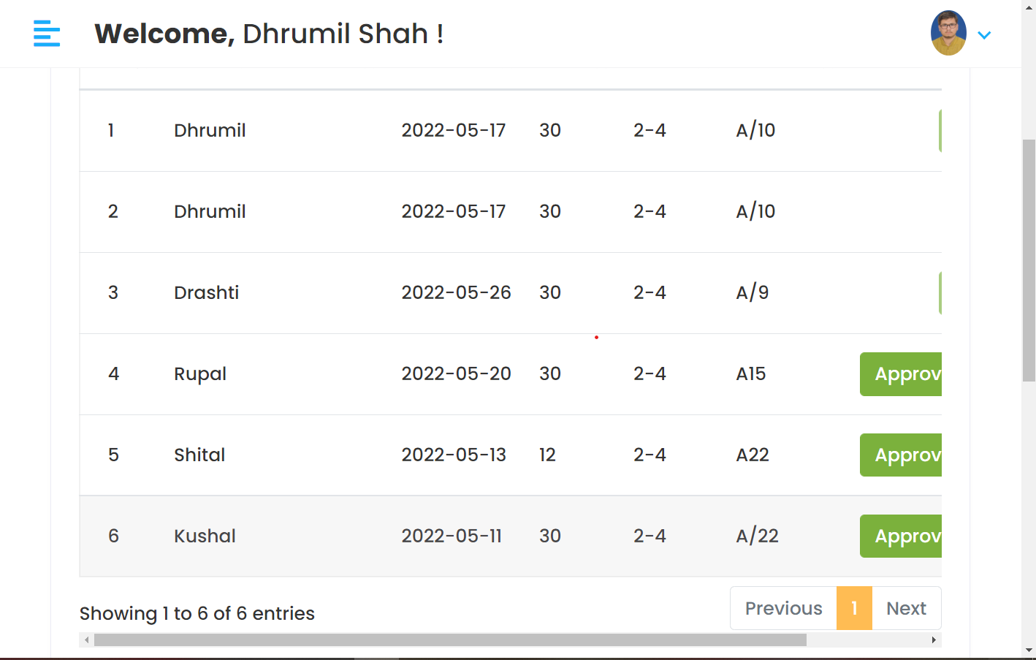
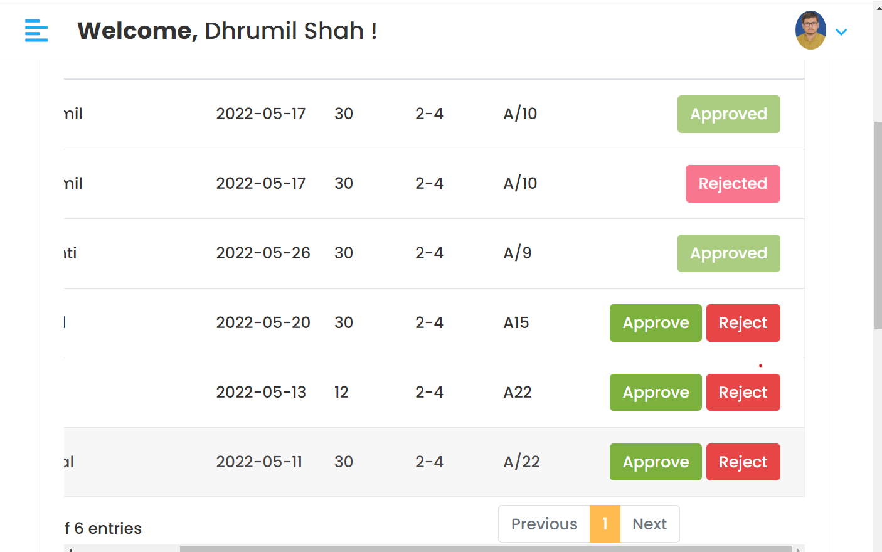
View Customer booking
and approve or rejct it

Slide 17
Functionalities Of Housekeeper
Housekeeper can apply for leave
Housekeeper can give feedback and view reply by admin
Housekeeper Update their profile
Housekeeper can view Notifications given by housekeeper and mark it as read

Slide 18
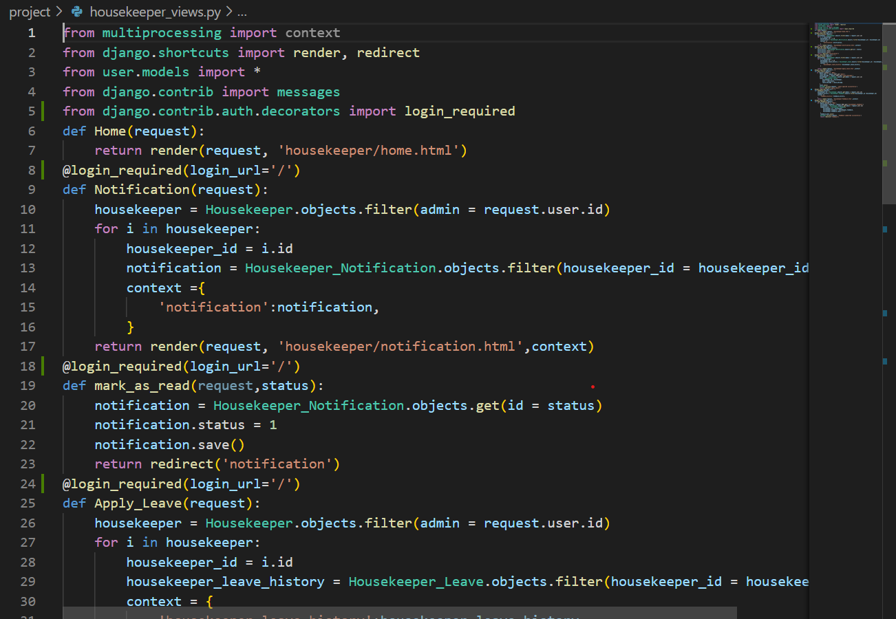
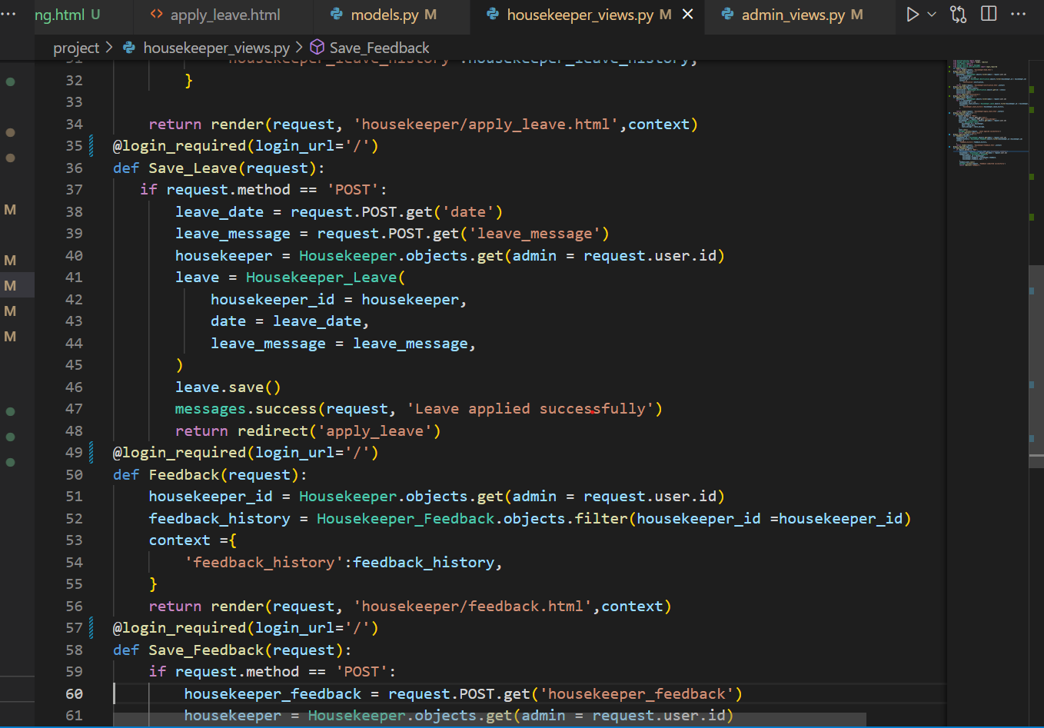
housekeeper_views.py

Slide 19
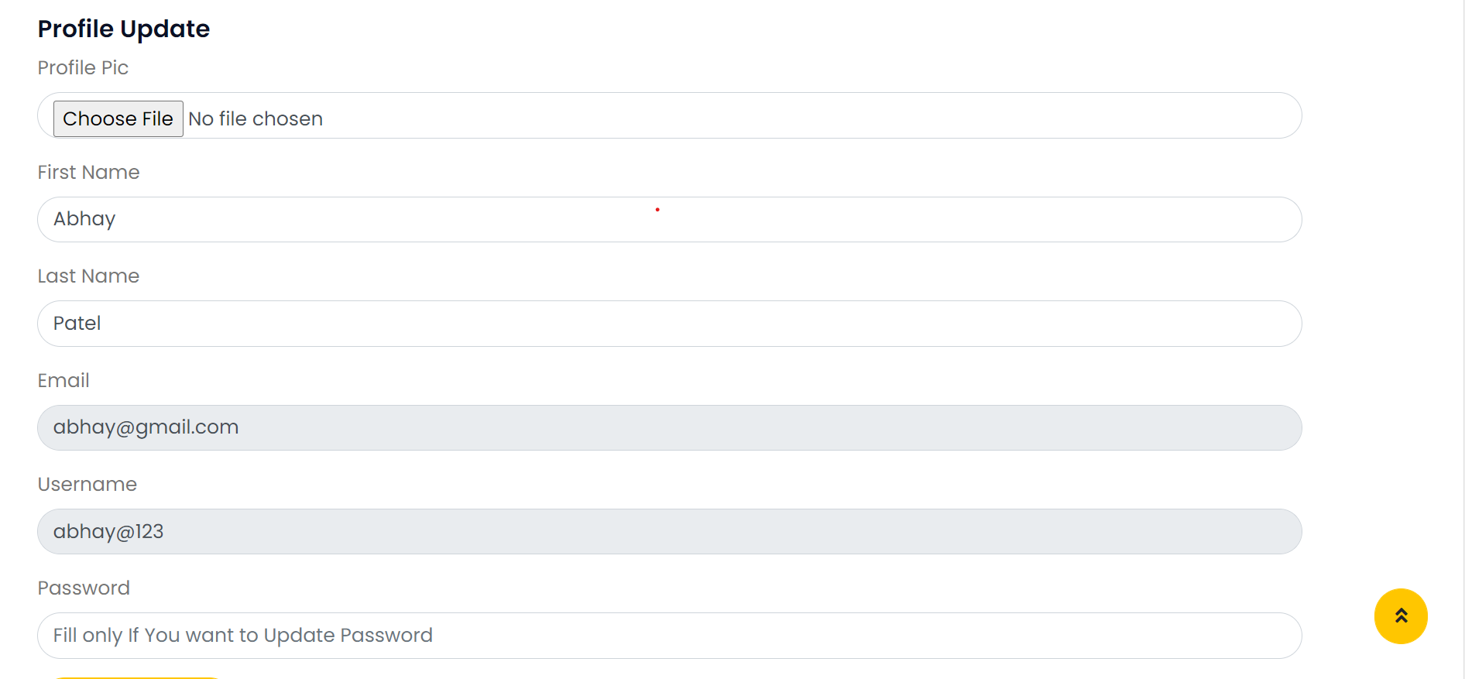
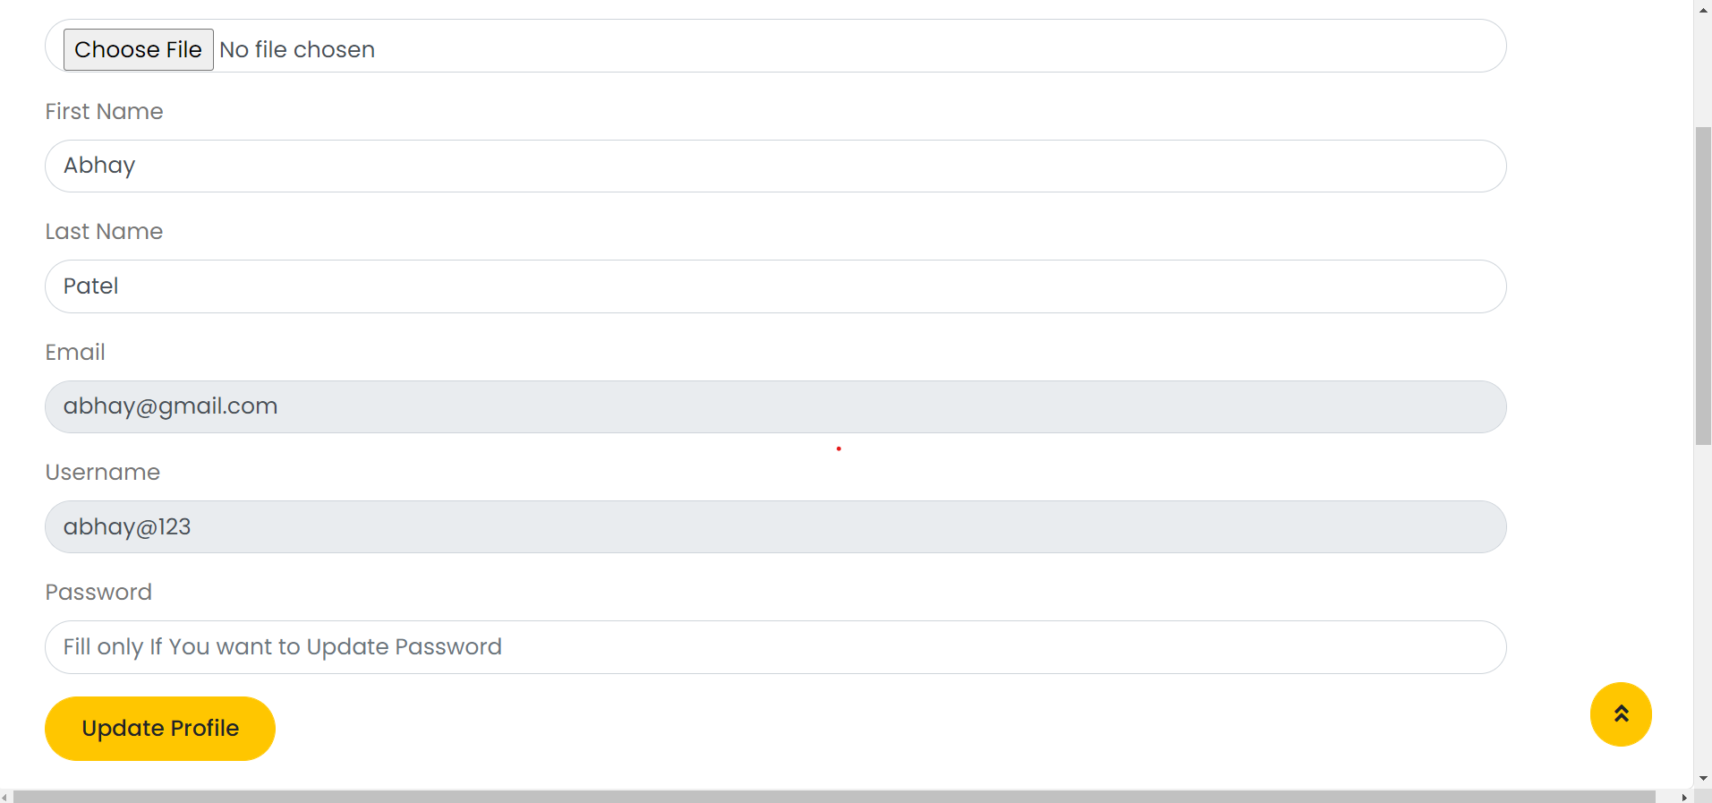
Housekeeper Update Profile

Slide 20
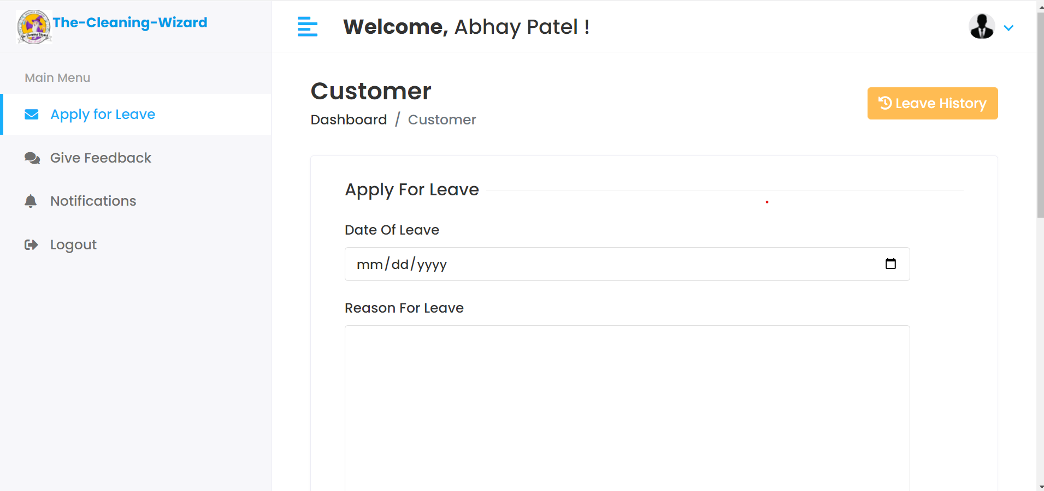
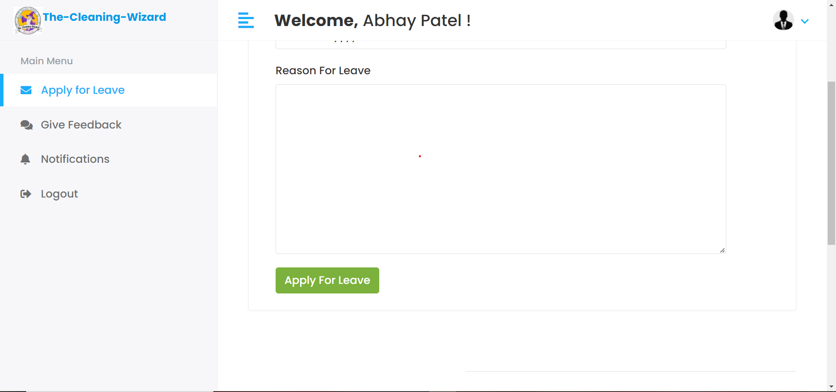
Housekeeper apply for leave
and view Leave History

Slide 21
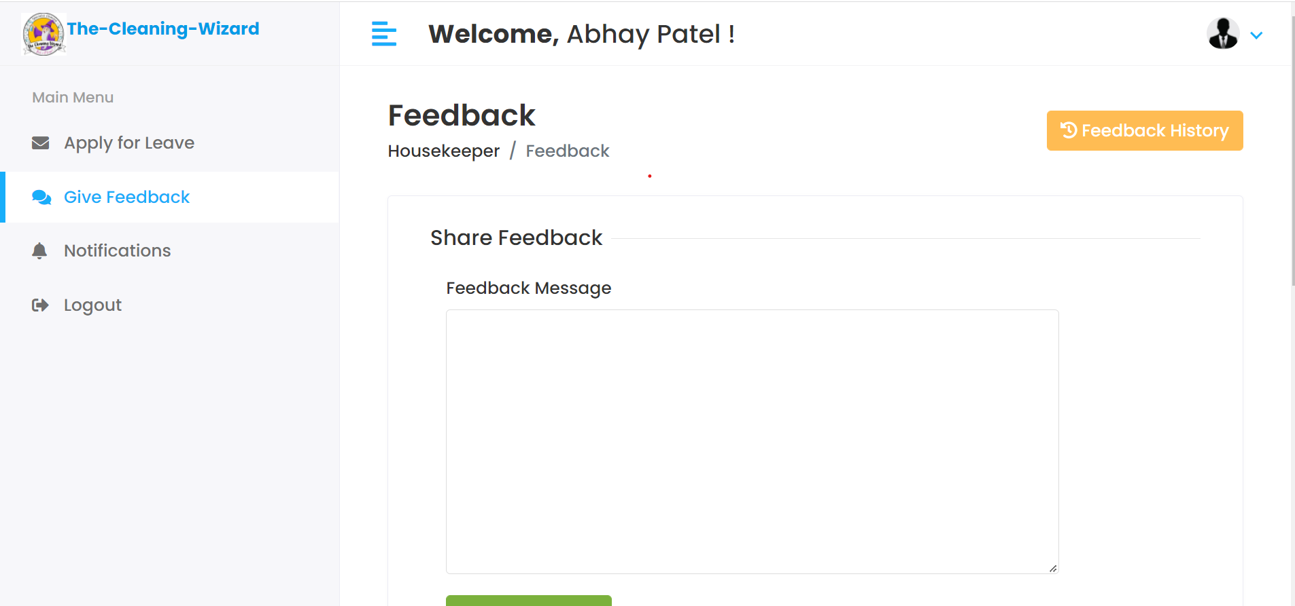
Housekeeper can share feedback
and view feedback History

Slide 22
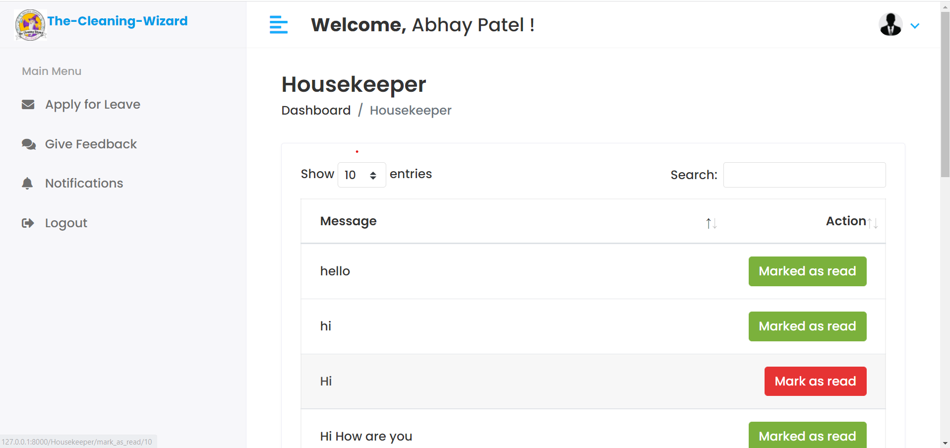
Housekeeper can view notification given by
Admin and mark it as read

Slide 23
Functionalities Of Customer
Customer provider can register
Customer can login
Customer update their profile
Customer can view Services added by admin
Customer can book Service
Customer can provide feedback

Slide 24
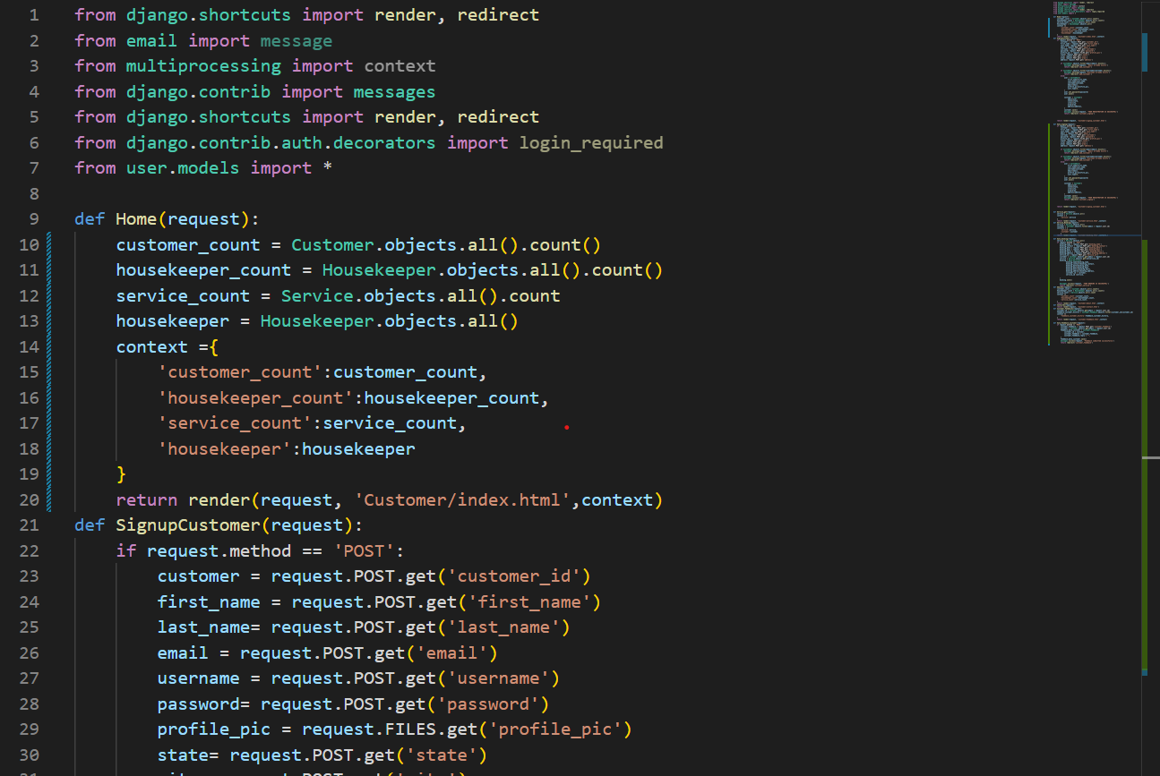
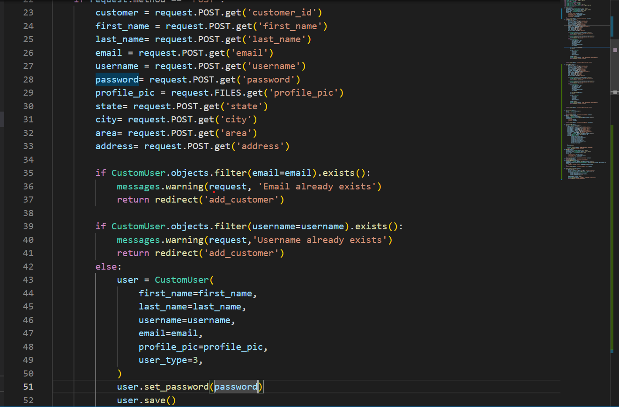
customer_views.py

Slide 25
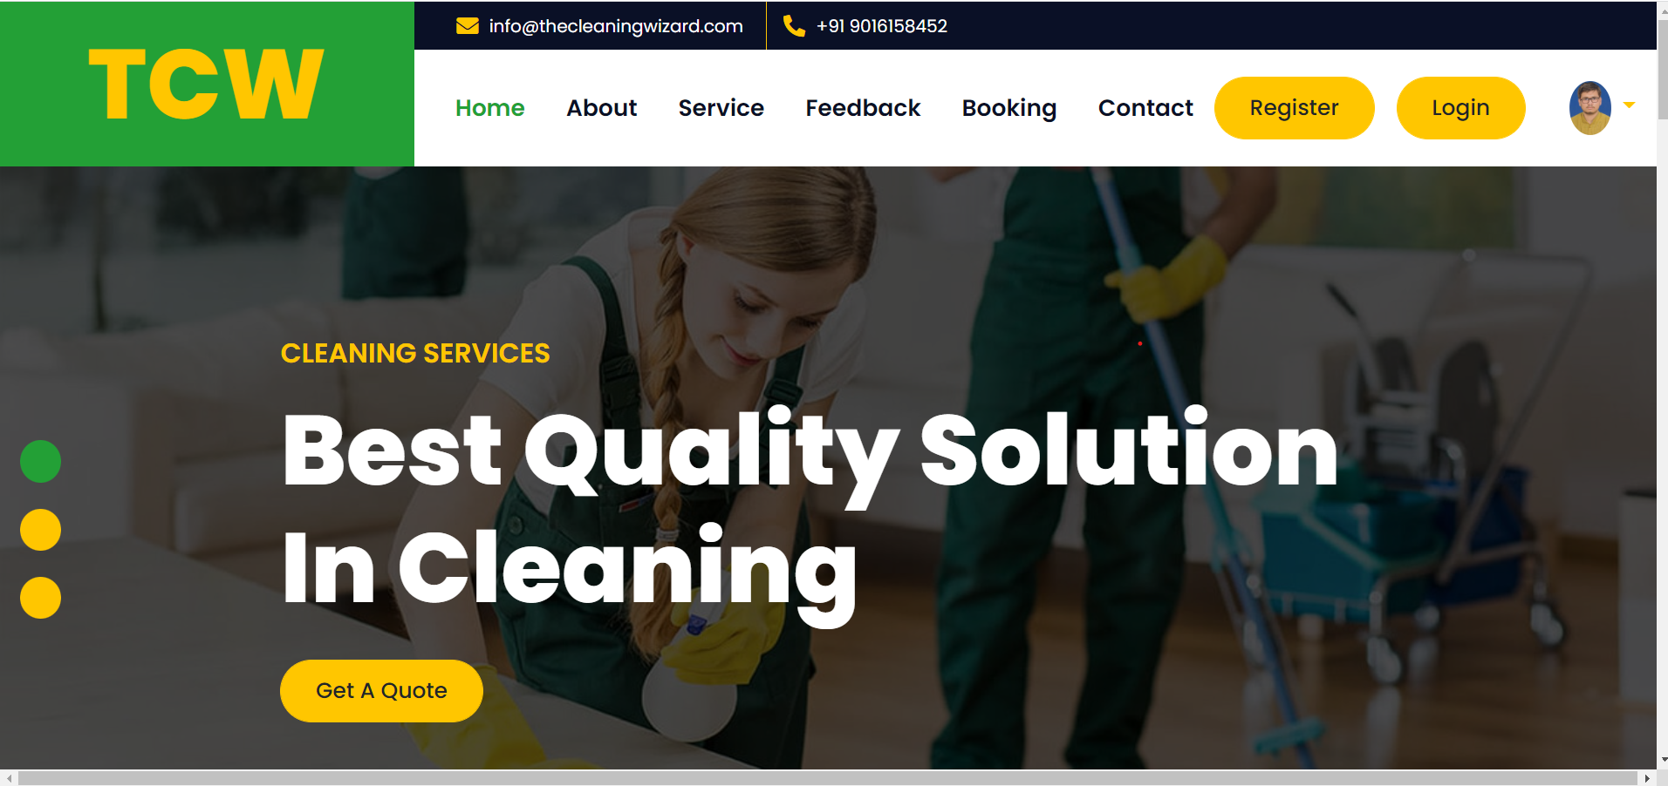
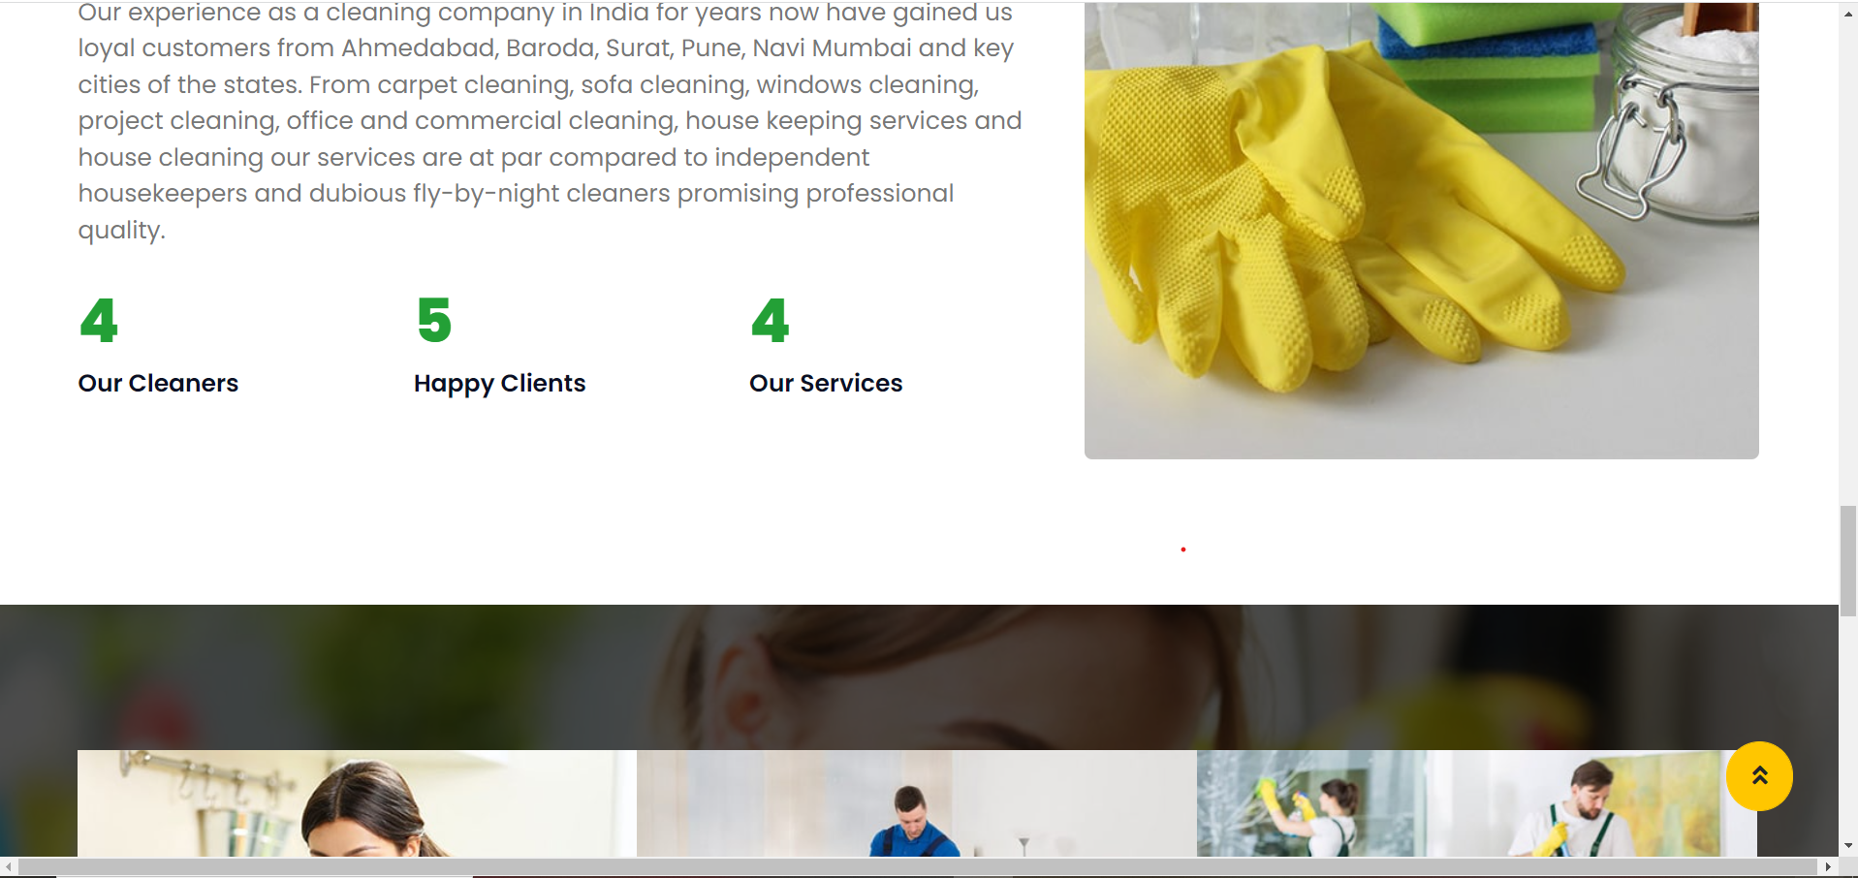
Customer Homepage

Slide 26
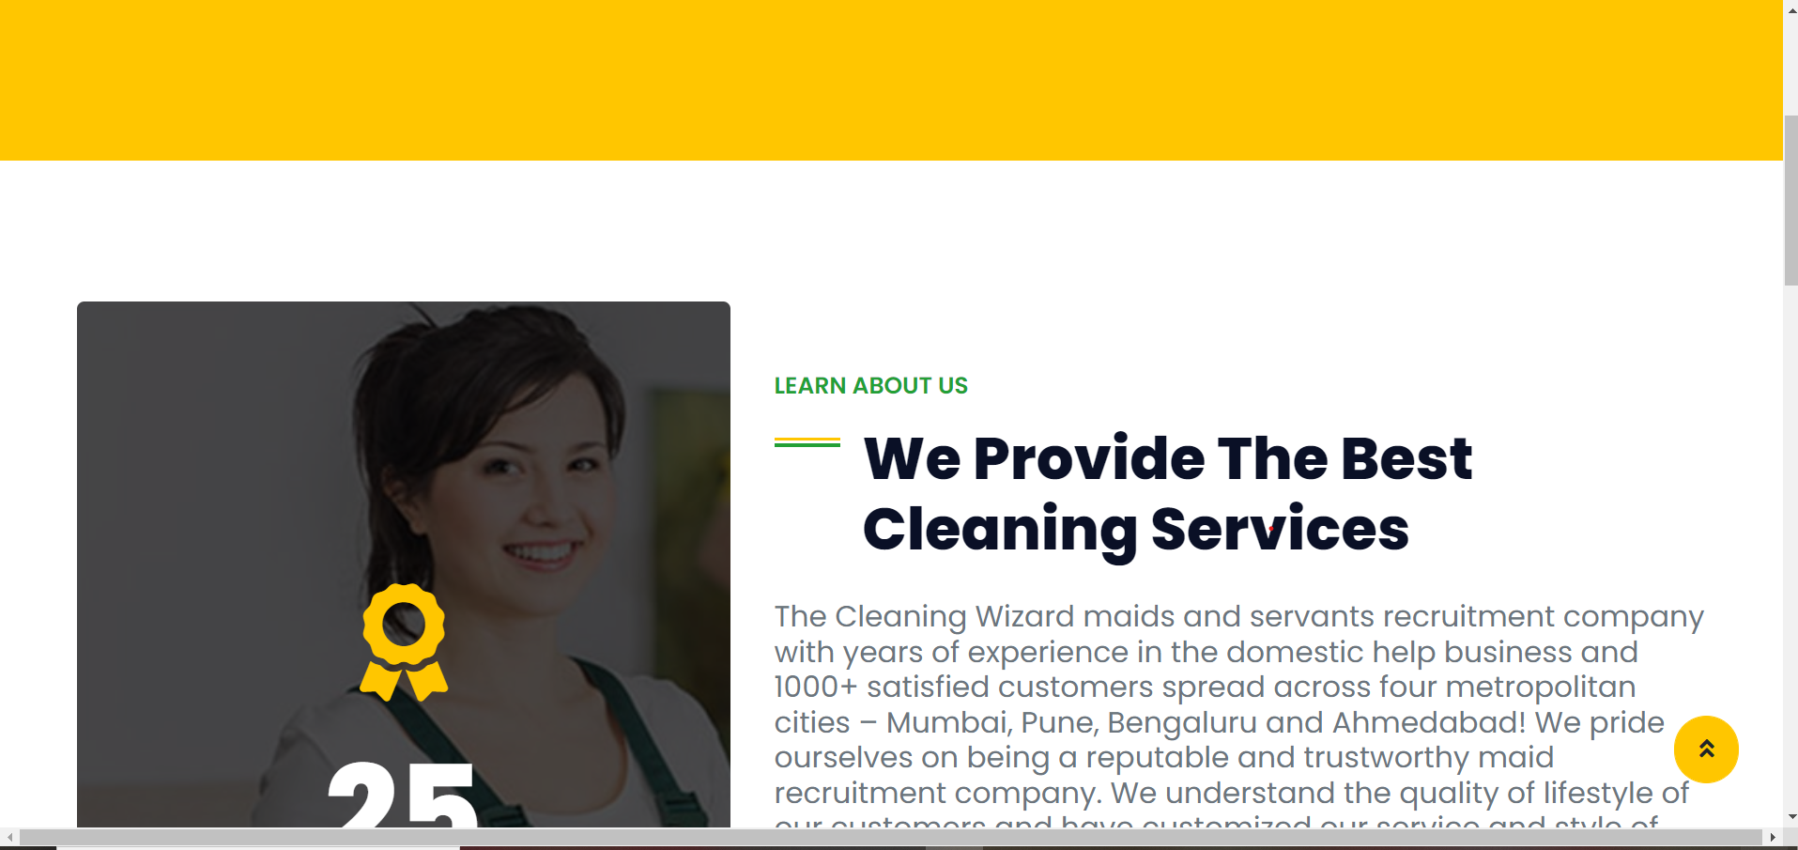
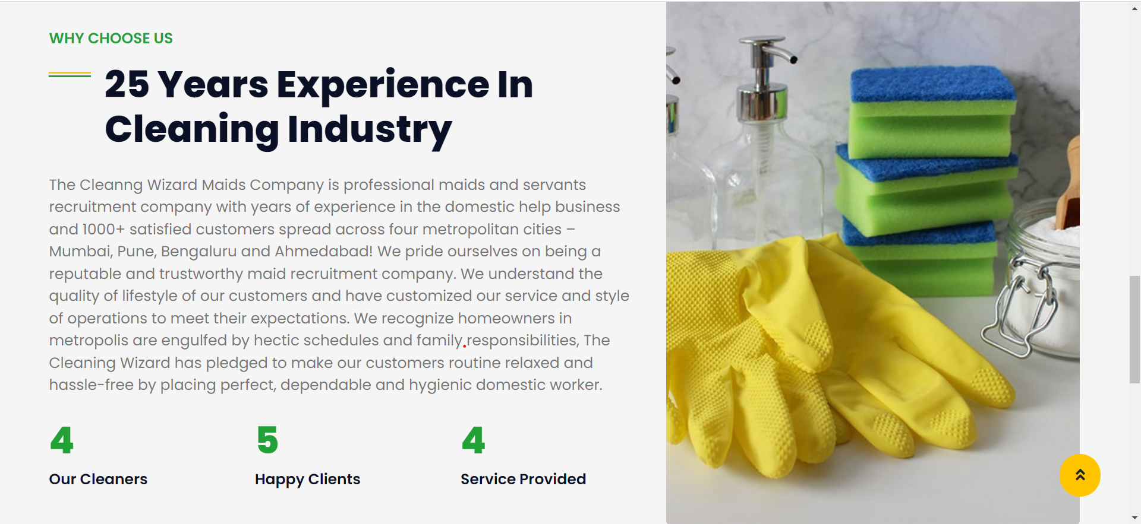
Customer AboutPage

Slide 27
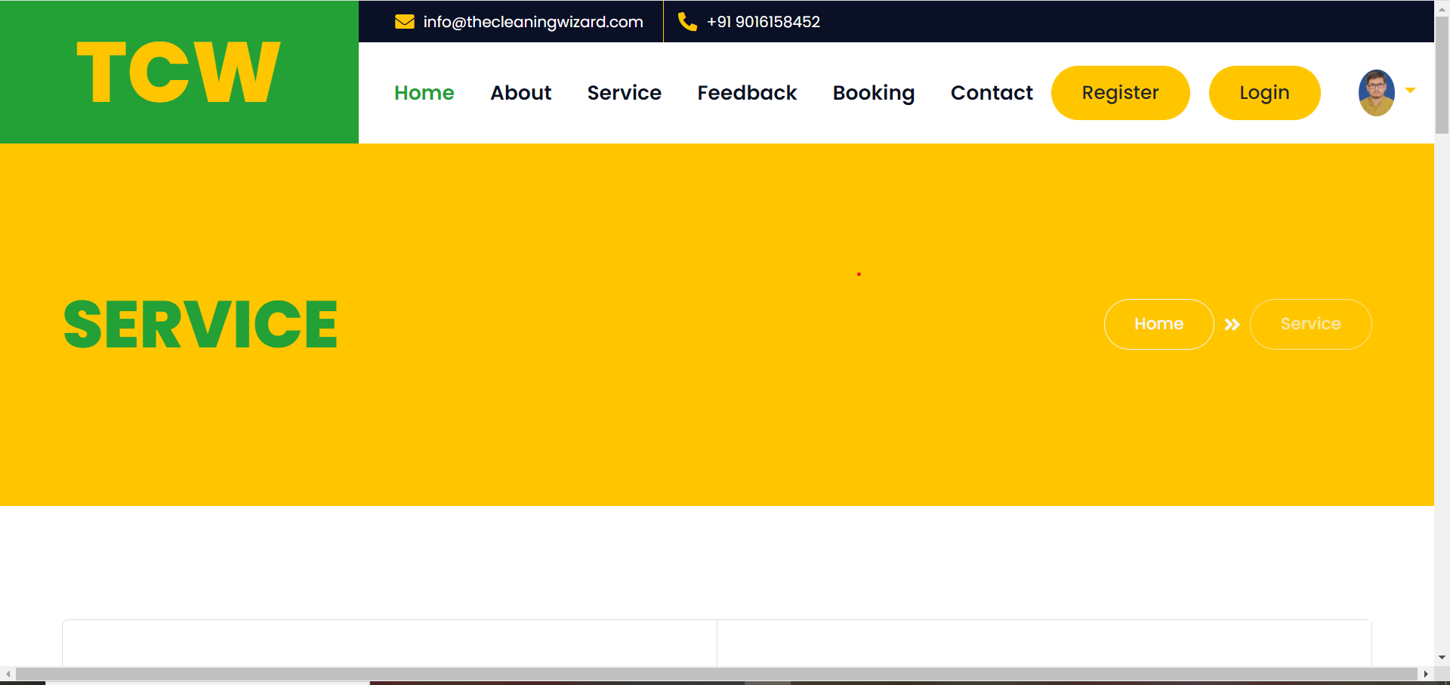
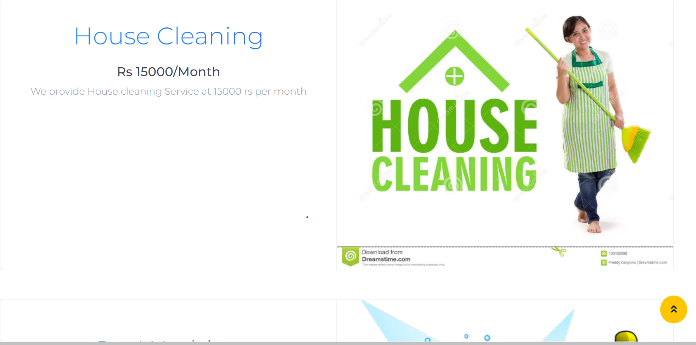
Customer ServicePage

Slide 28
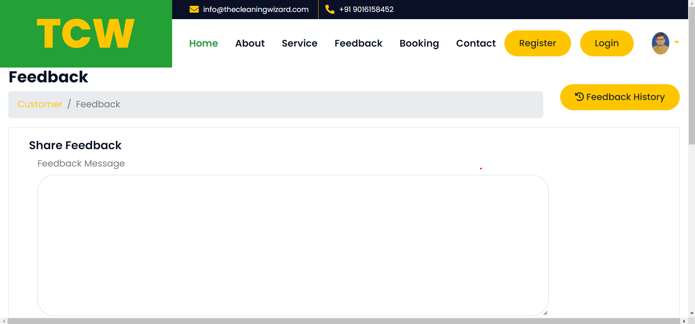
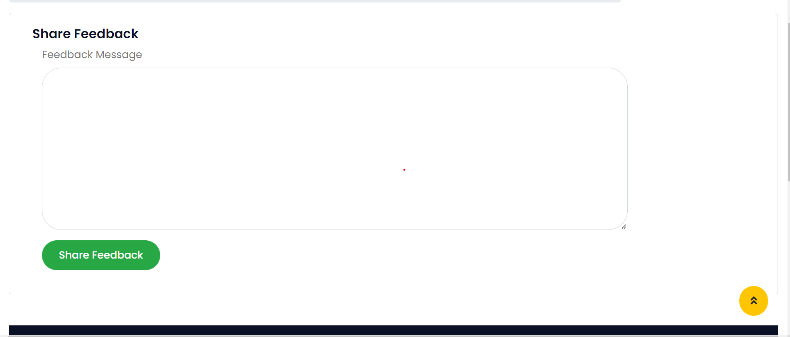
Customer Feedback Form

Slide 29
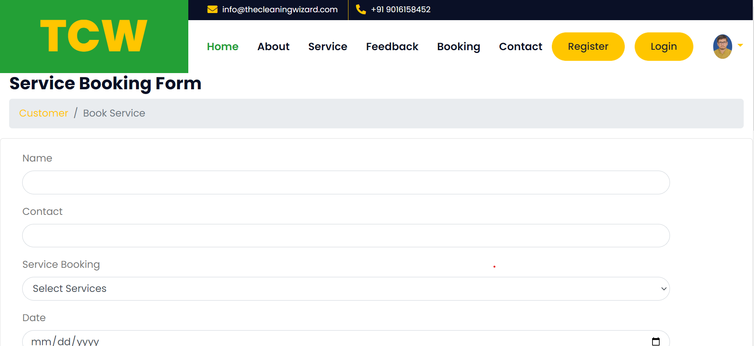
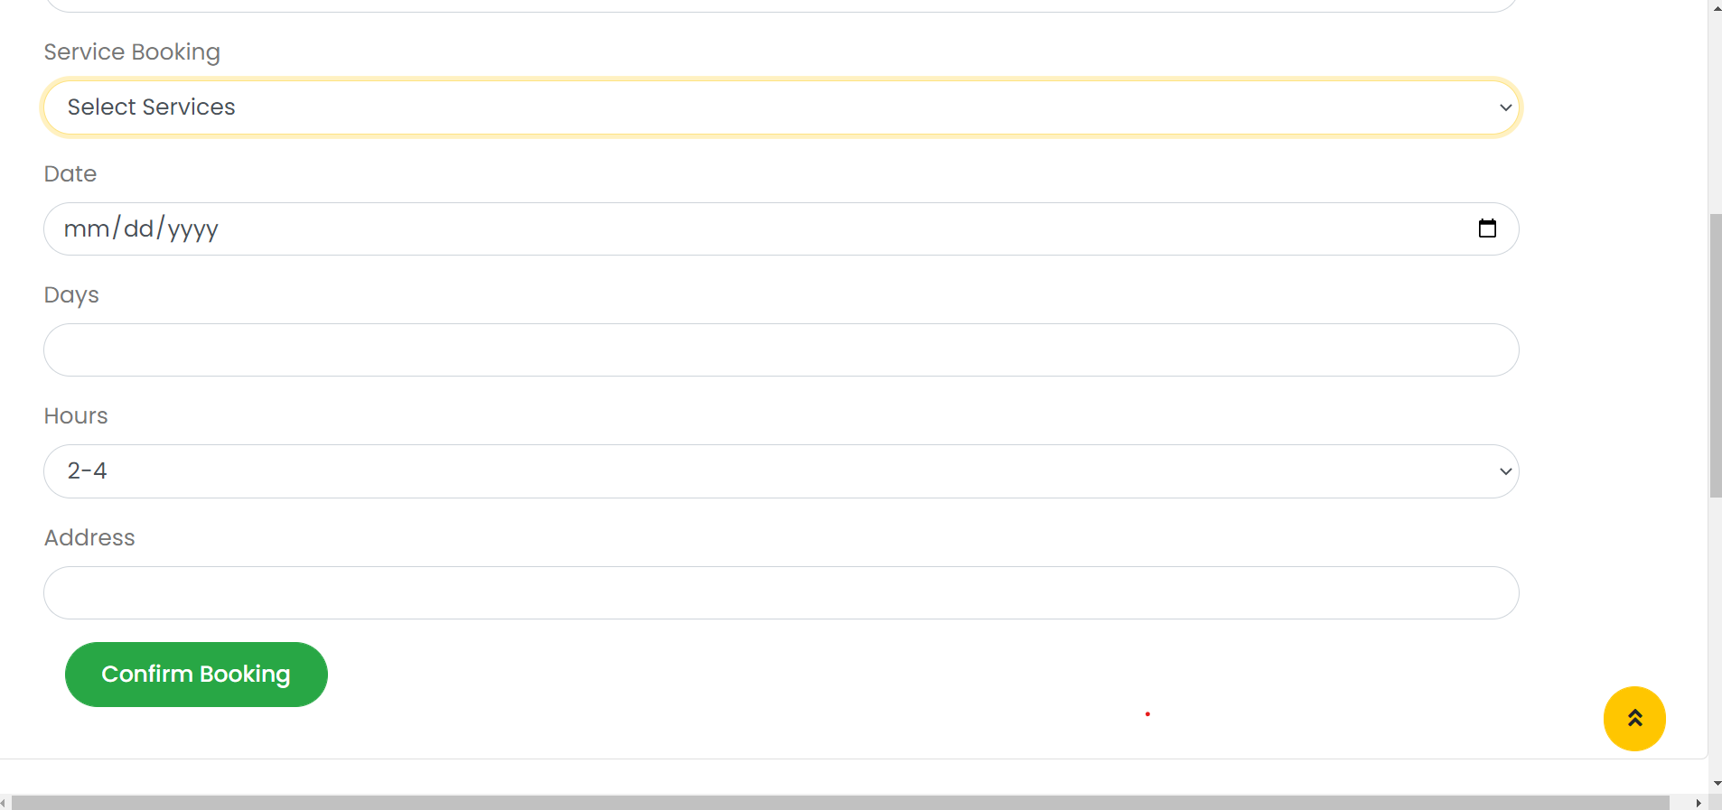
Customer Service Booking Form

Slide 30
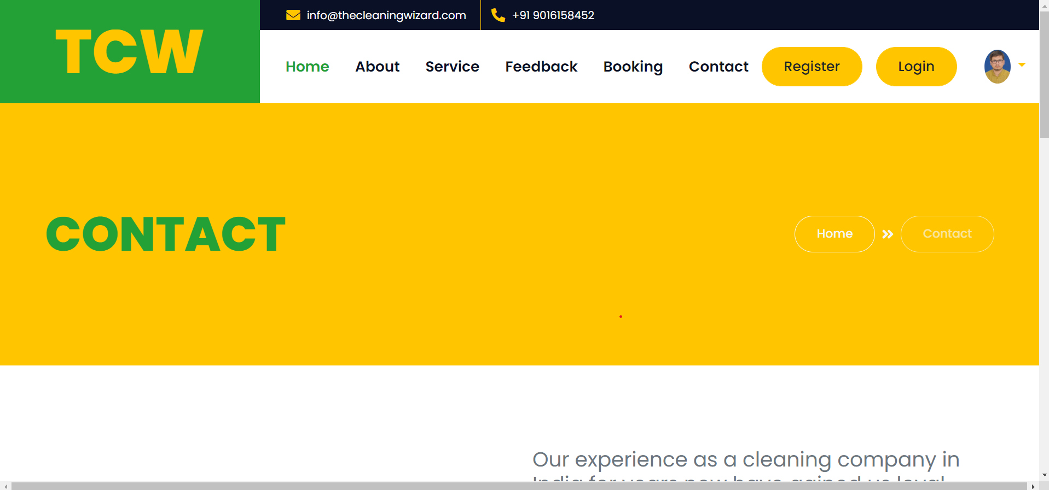
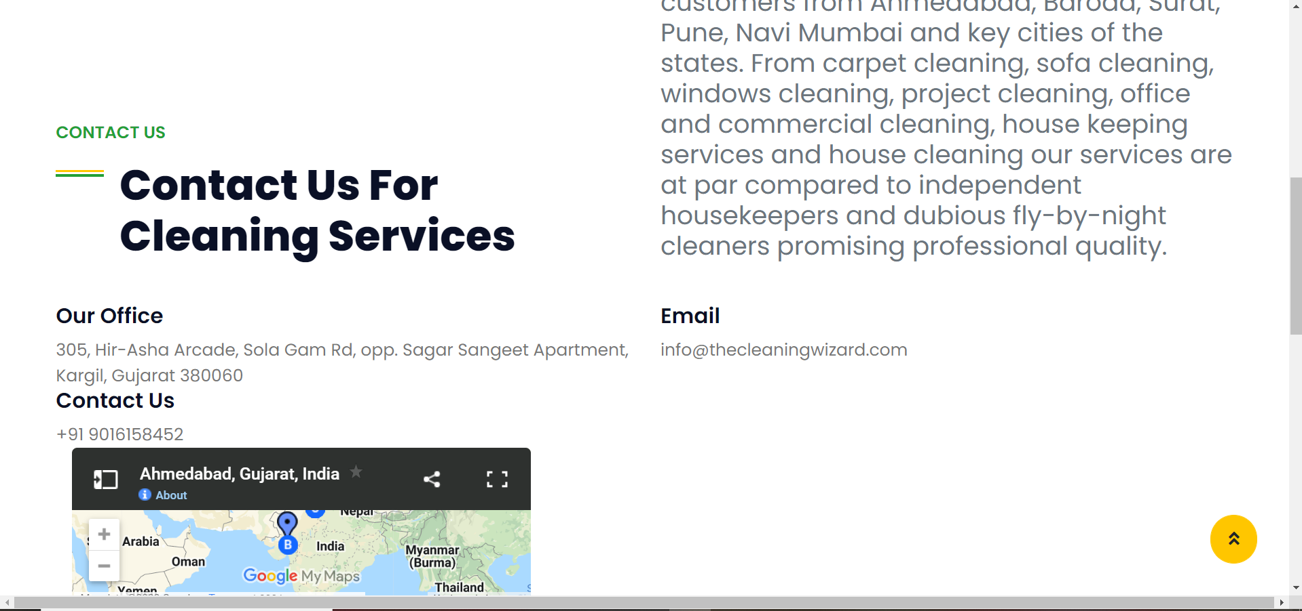
Customer ContactUs Form

Slide 31
Thank you

